Slide 1
Design Concepts and Principles
Instructor: Mehroze Khan

Slide 2
Design Principles
Design principles are guidelines for decomposing a system’s required functionality and behavior into modules
The principles identify the criteria
for decomposing a system
deciding what information to provide (and what to conceal) in the resulting modules
Six dominant principles (general):
Modularity
Interfaces
Information hiding
Incremental development
Abstraction
Generality

Slide 3
Modularity
Modularity is the principle of keeping the unrelated aspects of a system separate from each other,
each aspect can be studied in isolation (also called separation of concerns)
If the principle is applied well, each resulting module will have a single purpose and will be relatively independent of the others
Each module will be easy to understand and develop
Easier to locate faults
because there are fewer suspect modules per fault
Easier to change the system
because a change to one module affects relatively few other modules
To determine how well a design separates concerns, we use two concepts that measure module independence: coupling and cohesion
Notes:
Concerns can be functions, data, features, tasks, qualities, or any aspect of the requirements or design that we want to define or understand in more detail.

Slide 4
Modularity: Coupling
Two modules are tightly coupled when they depend a great deal on each other
Loosely coupled modules have some dependence, but their interconnections are weak
Uncoupled modules have no interconnections at all; they are completely unrelated

Slide 5
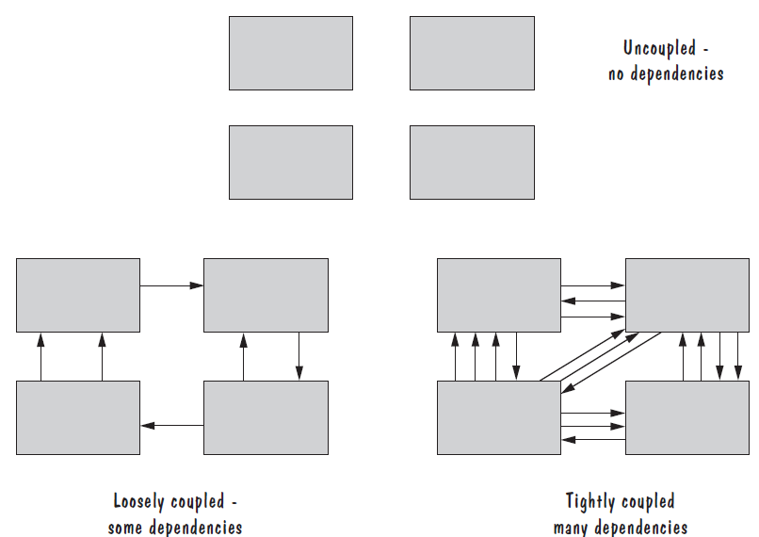
Modularity: Coupling

Slide 6
Modularity: Coupling
There are many ways that modules can depend on each other:
The references made from one module to another
The amount of data passed from one module to another
The amount of control that one module has over the other
Coupling can be measured along a spectrum of dependence, ranging from complete dependance to complete independence
Notes:
The references made from one module to another: Module A may invoke operations in module B, so module A depends on module B for completion of its function or process.
The amount of data passed from one module to another: Module A may pass a parameter, the contents of an array, or a block of data to module B.
The amount of control that one module has over the other: Module A may pass a control flag to module B. The value of the flag tells module B the state of some resource or subsystem, which procedure to invoke, or whether to invoke a procedure at all.

Slide 7
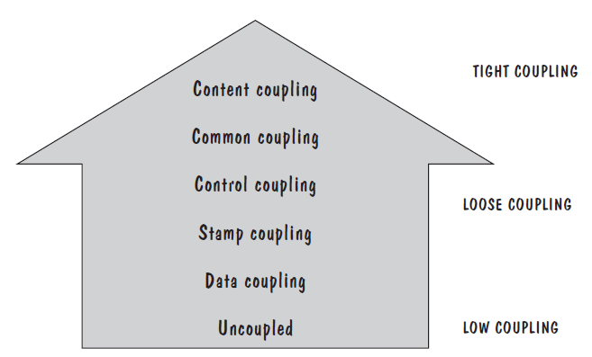
Modularity: Types of Coupling
Content coupling
Common coupling
Control coupling
Stamp coupling
Data coupling
High coupling is not desired

Slide 8
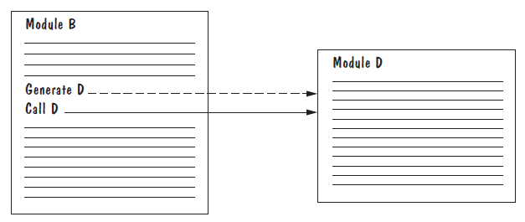
Modularity: Content Coupling
One module modifies another. The modified module is completely dependent on the modifying one
One class modifies the content of another class. For example, in C++, friend classes can access each other’s private members.
Content coupling might occur when one module is imported into another module, modifies the code of another module, or branches into the middle of another module

Slide 9
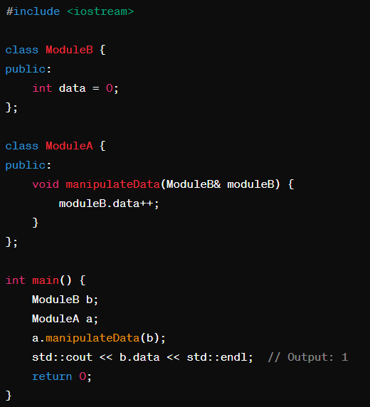
Modularity: Content Coupling
Consider a scenario where Module A directly accesses the variables of Module B and manipulates them. If Module B's internal structure or variable names change, Module A would need to be updated accordingly.

Slide 10
Modularity: Common Coupling
We can reduce the amount of coupling somewhat by organizing our design so that data are accessible from a common data store.
Dependence still exists; making a change to the common data means that, to evaluate the effect of the change, we must look at all modules that access those data.
With common coupling, it can be difficult to determine which module is responsible for having set a variable to a particular value.

Slide 11
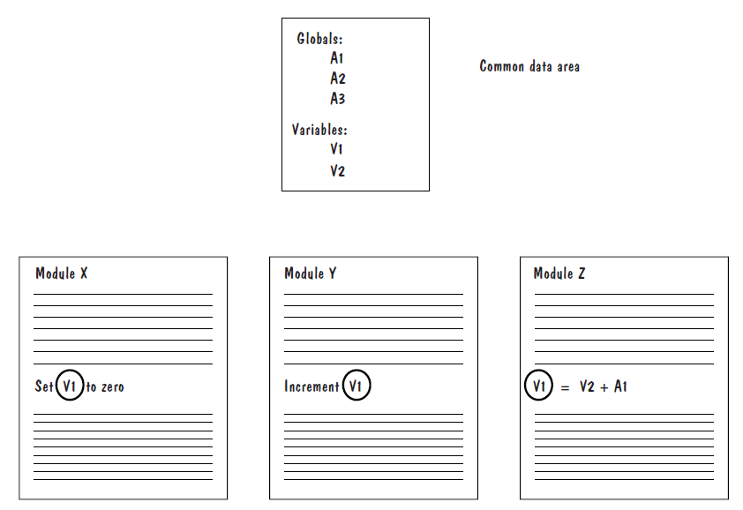
Modularity: Common Coupling

Slide 12
Modularity: Control Coupling
When one module passes parameters or a return code to control the behavior of another module
It is impossible for the controlled module to function without some direction from the controlling module
Limit each module to be responsible for only one function or one activity.
Restriction minimizes the amount of information that is passed to a controlled module
It simplifies the module’s interface to a fixed and recognizable set of parameters and return values.

Slide 13
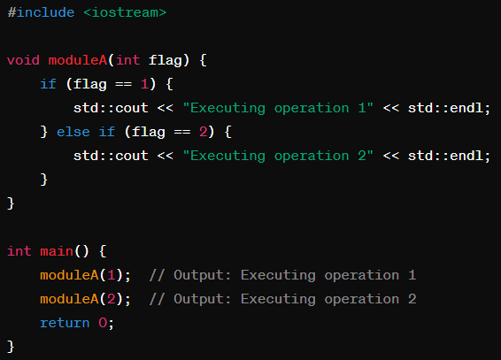
Modularity: Control Coupling

Slide 14
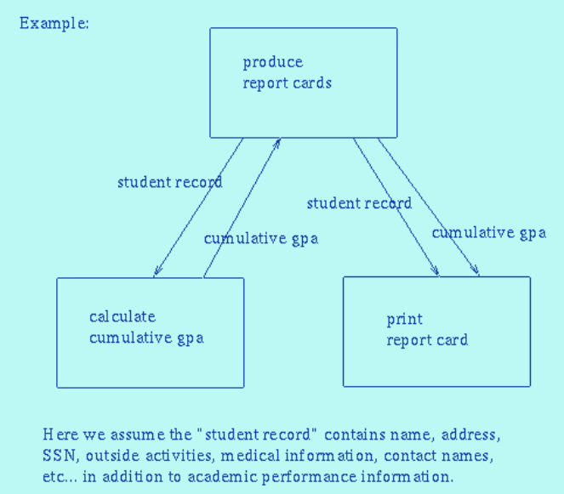
Modularity: Stamp Coupling
Stamp coupling occurs when modules exchange complex data structures, typically large parameters or data objects, instead of passing only the necessary information.
Stamp coupling represents a more complex interface between modules, because the modules have to agree on the data’s format and organization

Slide 15
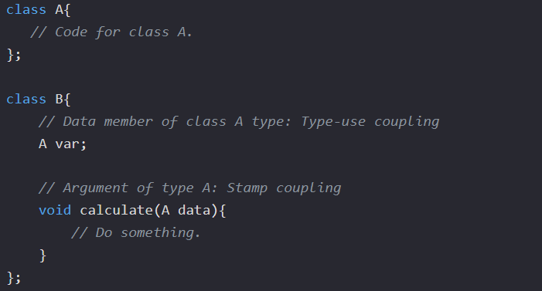
Modularity: Stamp Coupling
When the signature of one of Class B's functions has class A as its argument or return type.

Slide 16
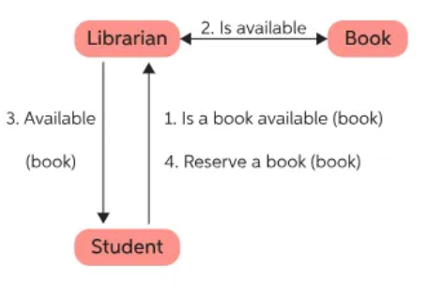
Modularity: Data Coupling
If only data values, and not structured data, are passed, then the modules are connected by data coupling
Data coupling is simpler and less likely to be affected by changes in data representation.
Easiest to trace data through and to make changes to data coupled modules.

Slide 17
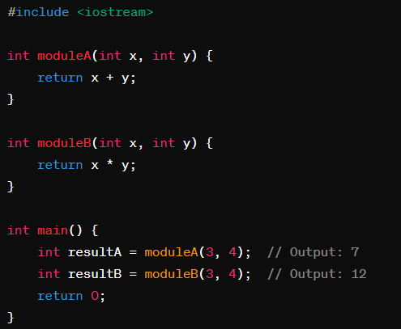
Modularity: Data Coupling

Slide 18
Modularity: Cohesion
Cohesion refers to the dependence within and among a module’s internal elements (e.g., data, functions, internal modules)
The more cohesive a module, the more closely related its pieces are

Slide 19
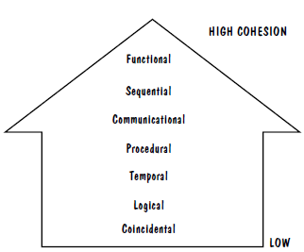
Modularity: Types of Cohesion
Coincidental cohesion
Logical cohesion
Temporal cohesion
Procedural cohesion
Communicational cohesion
Functional cohesion
Sequential cohesion
Low cohesion is not desired

Slide 20
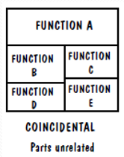
Modularity: Coincidental Cohesion
The worst degree of cohesion, coincidental, is found in a module whose parts are unrelated to one another
This is often considered the weakest form of cohesion because it doesn't reflect a logical design principle.
Unrelated functions, processes, or data are combined in the same module for reasons of convenience

Slide 21
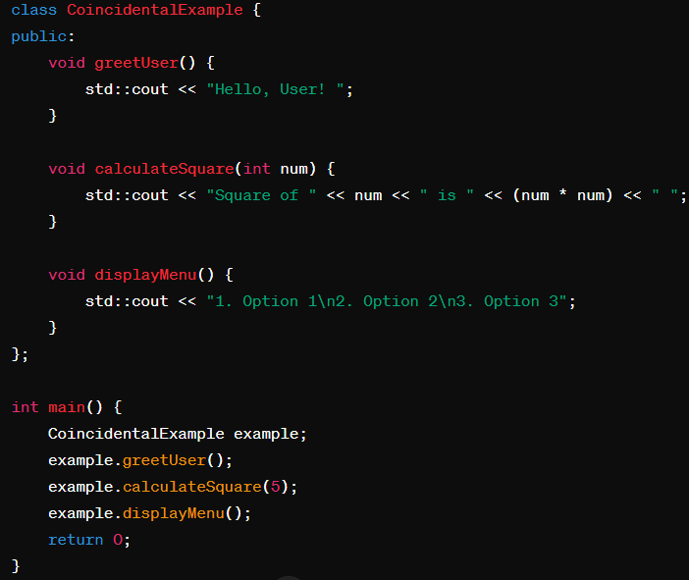
Modularity: Coincidental Cohesion

Slide 22
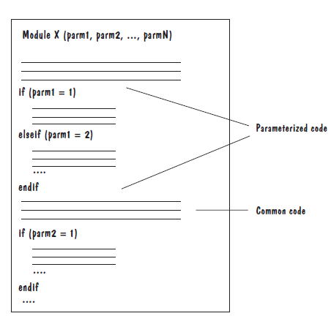
Modularity: Logical Cohesion
A module has logical cohesion if its parts are related only by the logic structure of its code

Slide 23
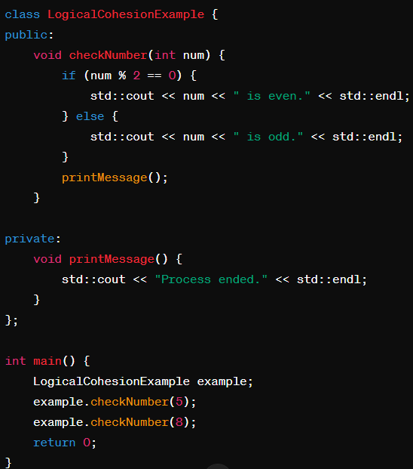
Modularity: Logical Cohesion

Slide 24
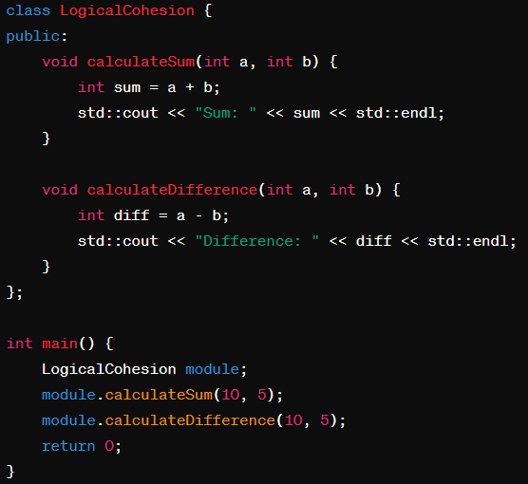
Modularity: Logical Cohesion

Slide 25
Modularity: Temporal Cohesion
Elements of component are related by timing.
Temporal cohesion occurs when elements within a module are executed sequentially due to their temporal relationship.
These elements may not be logically related but are performed together because they happen to be executed in sequence.

Slide 26
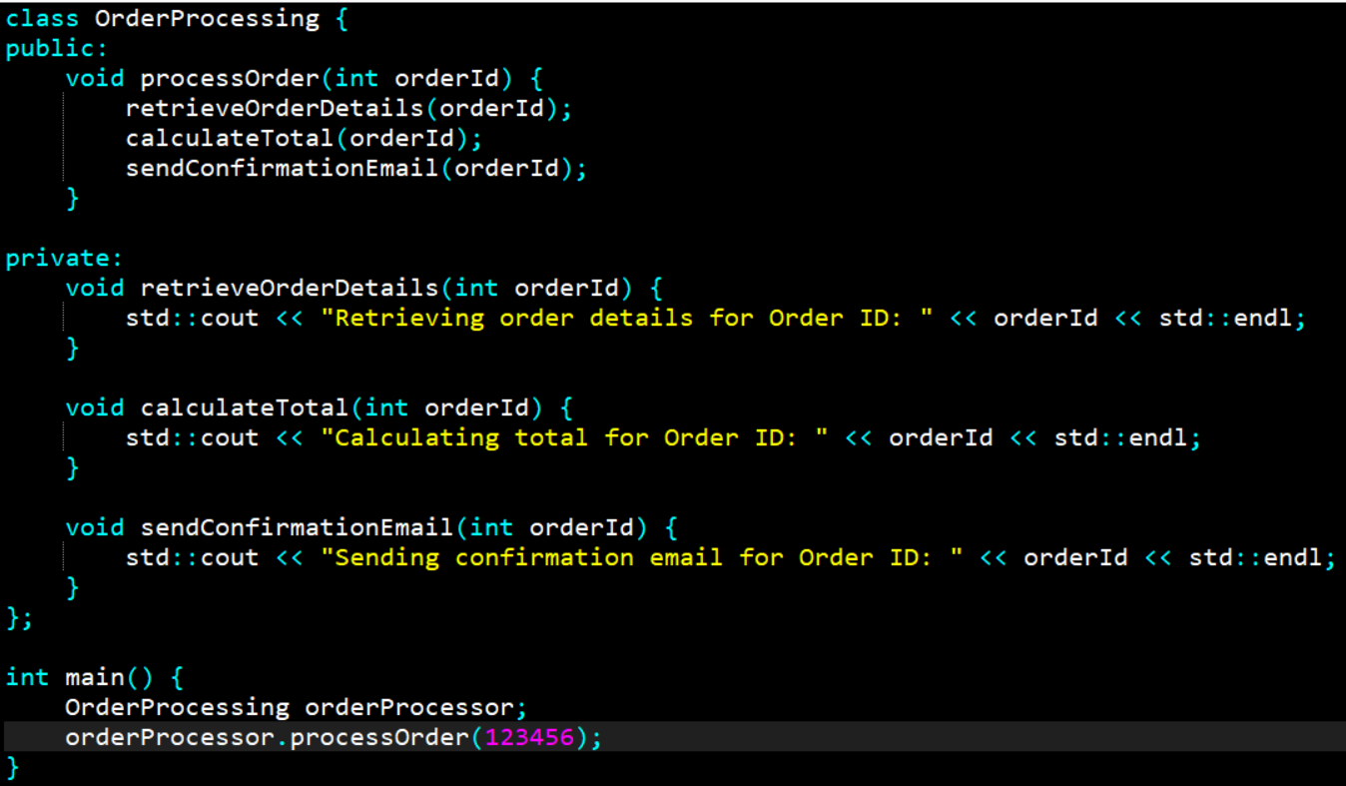
Modularity: Temporal Cohesion

Slide 27
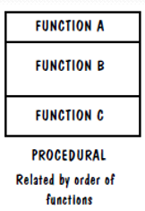
Modularity: Procedural Cohesion
Procedural cohesion occurs when elements within a module are grouped together because they are required to perform a specific task or procedure.
The elements work together to accomplish a common procedural goal.

Slide 28
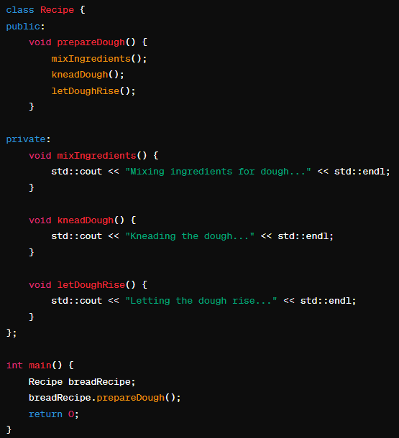
Modularity: Procedural Cohesion

Slide 29
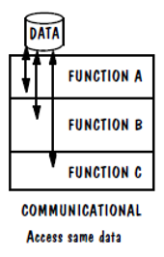
Modularity: Communicational Cohesion
Communicational cohesion occurs when elements within a module are grouped together because they operate on the same data or input/output.
The elements communicate with each other through shared data or parameters.

Slide 30
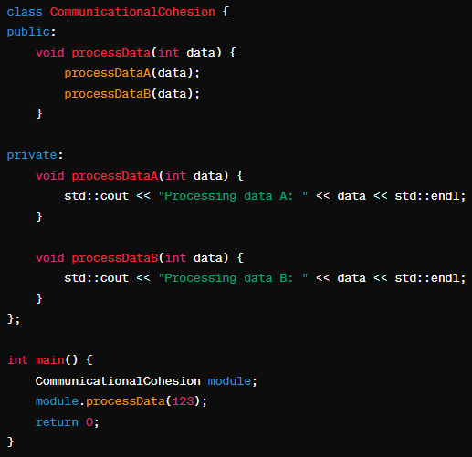
Modularity: Communicational Cohesion

Slide 31
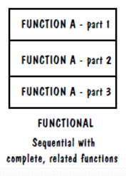
Modularity: Functional Cohesion
All elements essential to a single function are contained in one module, and all of that module’s elements are essential to the performance of that function
A functionally cohesive module performs only the function for which it is designed, and nothing else

Slide 32
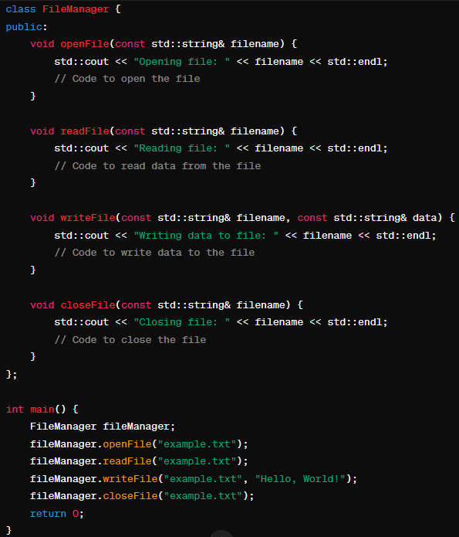
Modularity: Functional Cohesion

Slide 33
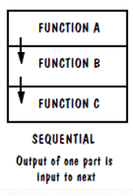
Modularity: Sequential Cohesion
Sequential cohesion is when parts of a module are grouped because the output from one part is the input to another part like an assembly line

Slide 34
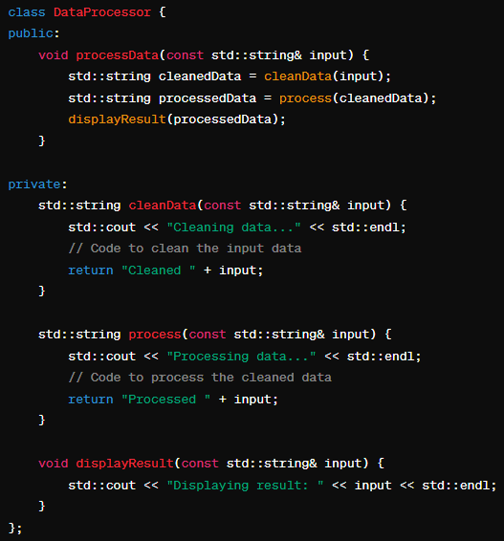
Modularity: Sequential Cohesion

Slide 35
Modularity: Informational Cohesion
Elements within a module are grouped together because they are related by providing information about a specific topic, entity, or concept.
In other words, the elements within the module are responsible for gathering, processing, and presenting information about a common subject.
The design goal is the same: to put data, actions, or objects together only when they have one common, sensible purpose.
For example, we say that an OO design component is cohesive if all of the attributes, methods, and action are strongly interdependent and essential to the object

Slide 36
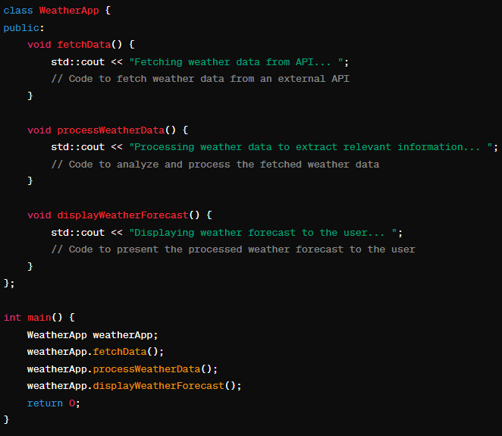
Modularity: Informational Cohesion

Slide 37
References
Shari PFleeger, Joanne Atlee, Software Engineering: Theory and Practice, 4th Edition
Roger S. Pressman, Software Engineering A Practitioner’s Approach, 6th Edition. McGrawHill

